Slide 1
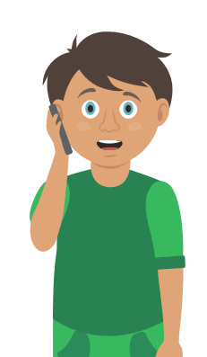
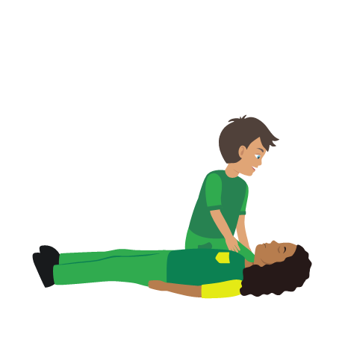
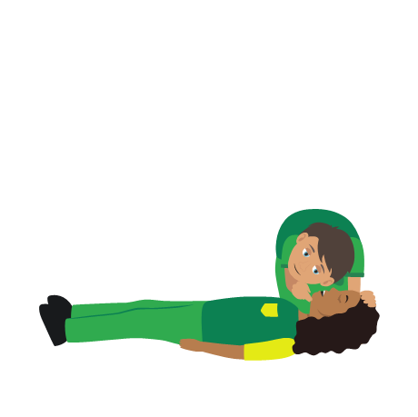
Starter Activity
Severe head injury
Use your current first aid knowledge to explain what you could do for each of the 5 steps.
Step 1.
Step 2.
Step 3.
Dial _ _ _/112 for emergency help
Do NOT m_ _ _ your casualty if you suspect they could have a n_ _ _ i_ _ _ _ _
Make sure the a_ _ _ _ _ is open
Step 4.
Step 5.
Treat any serious w_ _ _ _ _
Monitor casualty until
e_ _ _ _ _ _ _ _ help arrives

Slide 2
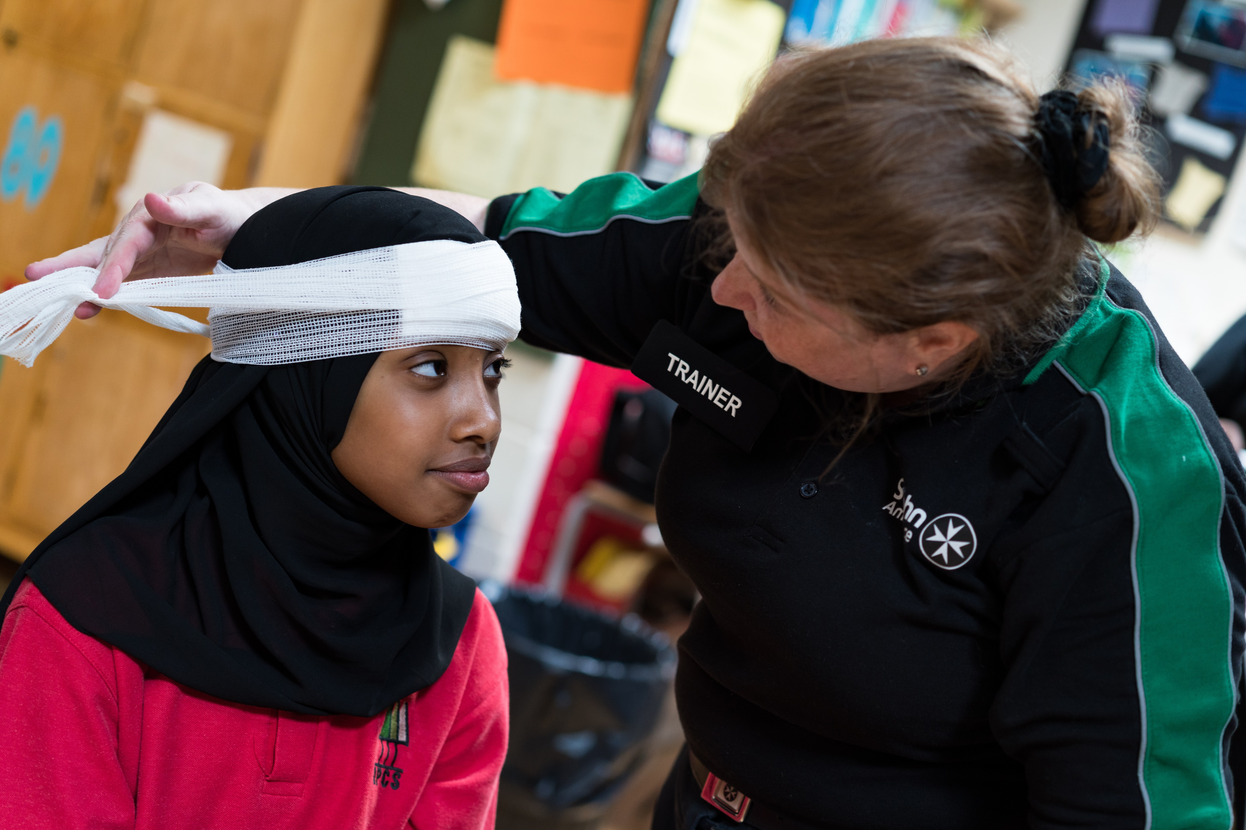


Head Injuries
KS3 – Head Injuries

Slide 3
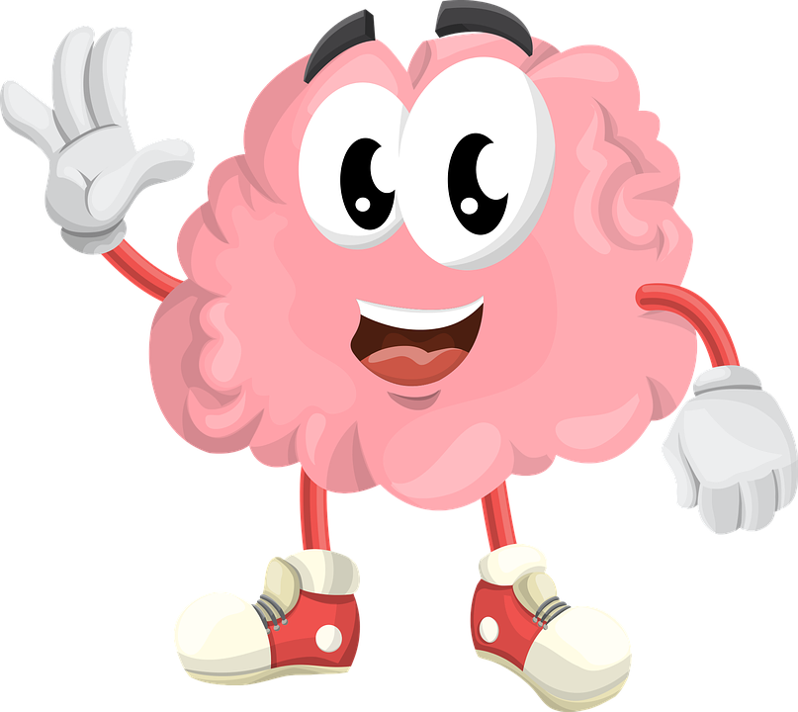
Head injuries
A short course to learn how to help someone who has a head injury.

Slide 4
Learning outcomes
I can identify a minor and a severe head injury
I can give first aid to a casualty who has a head injury
I can call for help for a casualty who has a head injury
Notes:
Teacher should refer to ground rules for the session at this stage

Slide 5
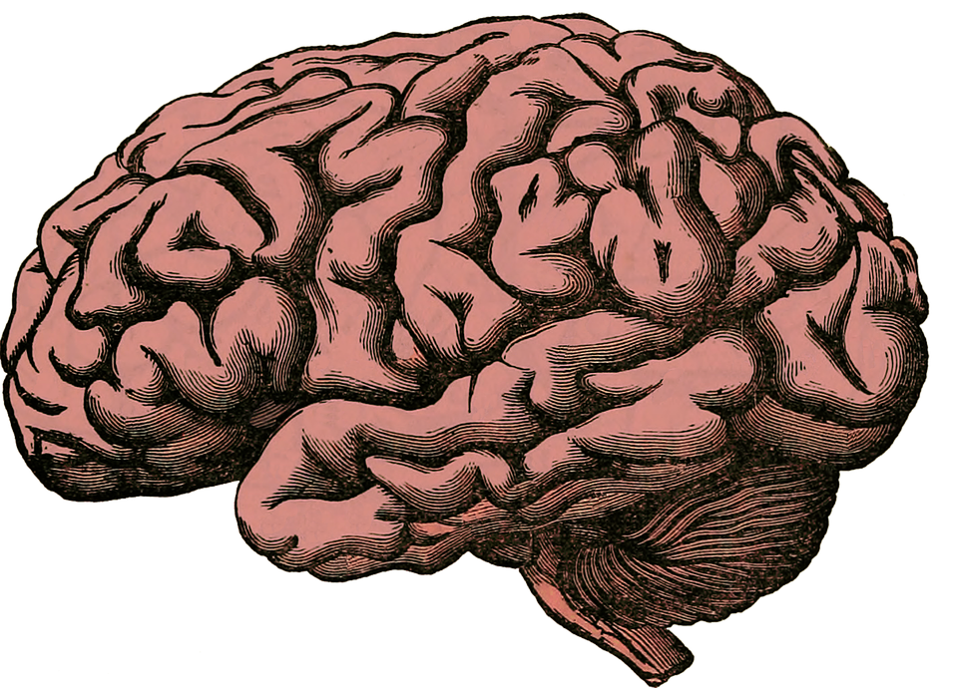
Brain facts
1. The human brain is like a powerful computer that operates the body.
2. It stores memories and controls how we move, think and react.
3. It keeps working, even when we are sleeping.
4. The brain is protected by the skull.
5. It uses 1/5 of our bodies energy.

Slide 6
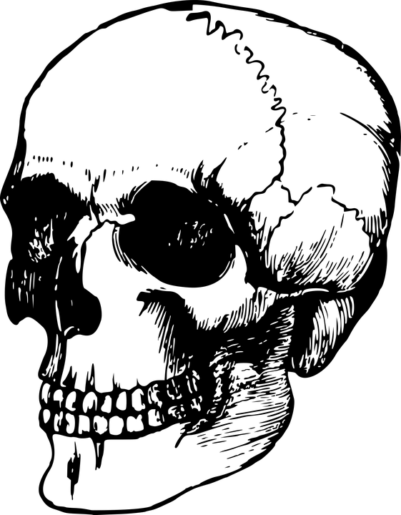
Skull facts
1. The skull (cranium) protects the brain (the brain is inside of it).
2. The human skull is made up of 22 different bones.
3. The muscles that enable us to make different facial expressions attach to the skull.
4. Being male or female, and your race, will affect the size and shape of your skull.
5. The jawbone is the only part of the skull that moves.

Slide 7
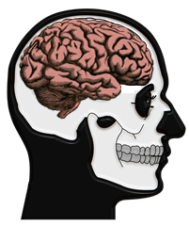
The brain
The brain is extremely delicate, so it sits inside the skull for protection.
An injury to the head can be dangerous and possibly cause damage to the brain.
This is because the brain is the control centre for our body, controlling our awareness, our decisions, our movements, our breathing and the heart.
Notes:
Discuss the image of skull protecting the brain.
Think of all the things that the brain controls, explain that in case of severe head injury, these could be affected.

Slide 8
Activity A18
This activity allows students to demonstrate their knowledge regarding functions of the brain.
If you wish to complete this activity, please use our downloadable worksheet found on the St John Ambulance website.

Slide 9
Mild vs Severe
Signs of a MILD head injury could be:
Wound to head
Dizziness and/or feeling sick
Confusion
Mild headache
Level of response may be affected for a brief period
Loss of memory at the time or immediately before the injury
REMEMBER a mild head injury could become worse
Signs of a SEVERE head injury could be:
History of severe blow to the head
Declining level of response. They may become unresponsive
Casualty may become unresponsive
Blood or bloodstained watery fluid leaking from ear or nose
Unequal pupil size
Notes:
If bleeding or swelling in brain then what seems a mild head injury initially could become a severe head injury.

Slide 10
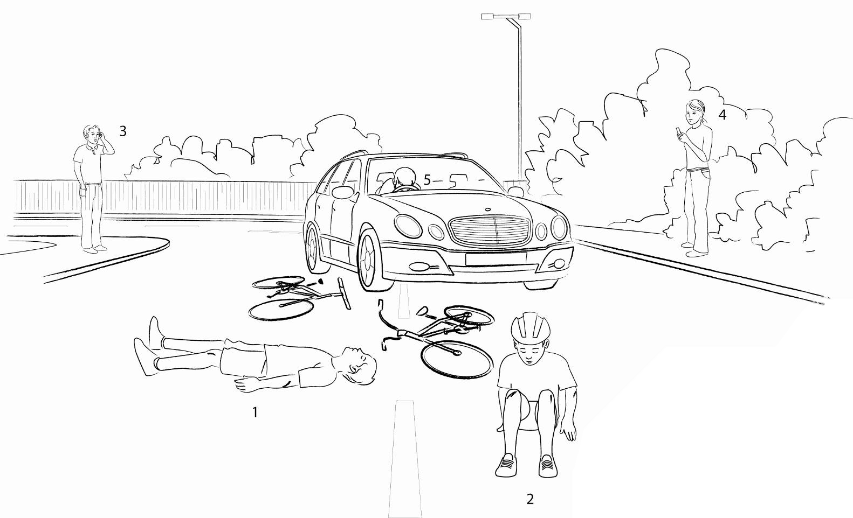
What do you see?
What do you see? Who could have a head injury? Explain your answer.
Notes:
What do you see?
Not wearing helmet v wearing helmet
Driver - head on steering wheel (seatbelt)
Discuss head injury possible in two instances i.e. when cyclist first hits car and then hits the floor!
Accident prevention advice - wear a helmet!

Slide 11
Types of head injury
Concussion
Temporary injury to the brain usually caused by a bump, blow or jolt to the head
Temporary loss of responsiveness
Confused but only for a short time
Makes a full recovery
Compression
Bleeding and/or swelling inside of the skull
Skull fracture
A crack or break in the skull

Slide 12
Seeking medical advice
Following a head injury , which of the following do you think somebody should seek medical advice for?
Difficulty speaking and/or walking
Confusion
Drowsiness that is getting worse
Double vision
A headache that is not getting better
Loss of memory and/or dizziness
Vomiting
Seizure (fitting)
Notes:
Answer ALL of them!
All are signs of worsening head injury so if any of these signs are evident you MUST seek medical help.

Slide 13
Watch this video
HEAD INJURY

Slide 14
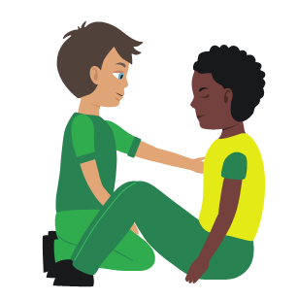

Your turn: Minor head injury
1. Help your casualty to sit down
2. Apply a cold compress to the injured area
Treat any wounds
3. Monitor your casualty
Watch for drowsiness and vomiting
4. Get help if necessary
Notes:
Scenario cards are available which the teacher can use to make the practical activity relevant in a certain context for students.
Trainer demonstrates then gets the students to practice using either the PP slide as a prompt or the sheet in the workbook. Trainer circulate and correct as necessary
Severe head injury to be covered with severe bleeding

Slide 15
Your turn: Severe head injury
1. Dial 999/112 for emergency help
2. Do NOT move your casualty if you suspect they could have a neck injury
3. Make sure the airway is open
4. Treat any serious wounds
5. Monitor casualty until emergency help arrives
Notes:
Scenario cards are available which the teacher can use to make the practical activity relevant in a certain context for students.
Trainer demonstrates then gets the students to practice using either the PP slide as a prompt or the sheet in the workbook. Trainer circulate and correct as necessary
Severe head injury to be covered with severe bleeding

Slide 16
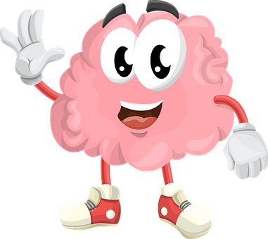
Quiz time (answers on slides 26-27)
1. Name one sign of a head injury.
2. State one way to prevent a head injury.
3. Name the part of the body which protects the brain.
4. How many bones form the skull?
5. Name one thing that the brain controls.
6. Describe how somebody would treat a head injury.
(minor/severe)
Bonus question…
Name one type of head injury and explain what it.is

Slide 17
Activity A1
This activity provides students with the opportunity to create a head injury prevention poster. If you wish to complete this activity, please use our downloadable worksheet found on the St John Ambulance website.

Slide 18
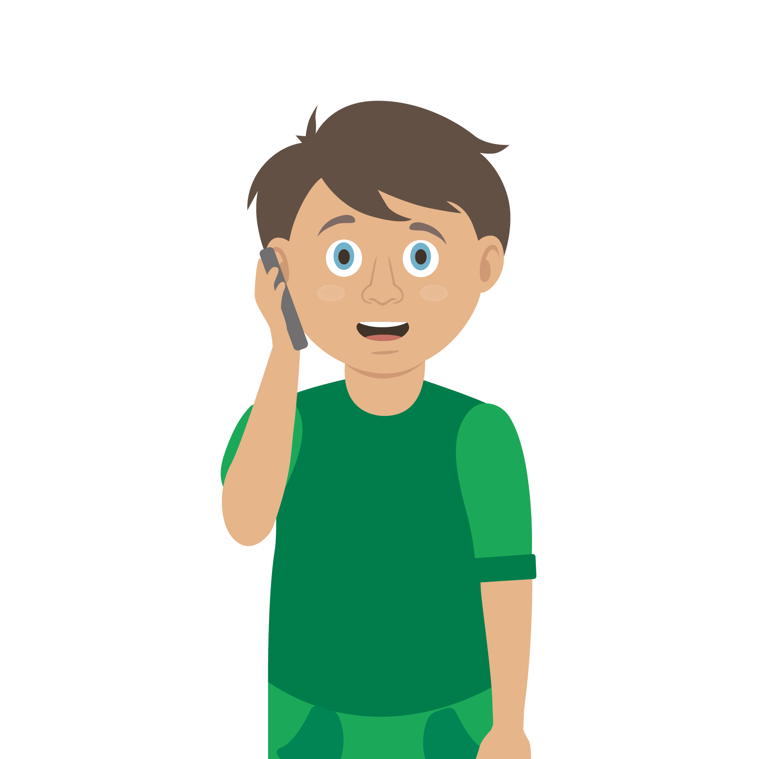
Casualty care
Pause for thought...
Which actions do you think are most important when caring for a casualty?
Get help
No food or drink
Prevent condition worsening
Remain calm
Keep warm
Treat with dignity and respect
Reassure casualty
Communicate well
Notes:
Opportunity to discuss common casualty care skills which are necessary in all first aid situations.

Slide 19



Check your learning
I am able to:
Identify minor and severe head injuries
Give first aid to a casualty who has a head injury
Call for help for a casualty with a head injury
YES UNSURE NO

Slide 20

Check your knowledge
Severe head injury
Revisit the starter activity on the first slide of this presentation. Using a coloured pen can you....
1. Add more detail to your previous answers?
2. Make any corrections?

Slide 21

Information and support
If any of the content in this session has upset or concerned you please discuss this with one of the teachers at your school
Further support can be found at:
www.childline.org.uk
www.youngminds.org.uk
www.samaritans.org
Further information linked to first aid can be found at:
www.sja.org.uk
www.asthma.org.uk

Slide 22

Thank you!

Slide 23
Activity A18
What does the brain do? do?
Students now have the opportunity to demonstrate their learning regarding functions of the brain. Use our downloadable worksheet which can be found on the St John Ambulance website.

Slide 24
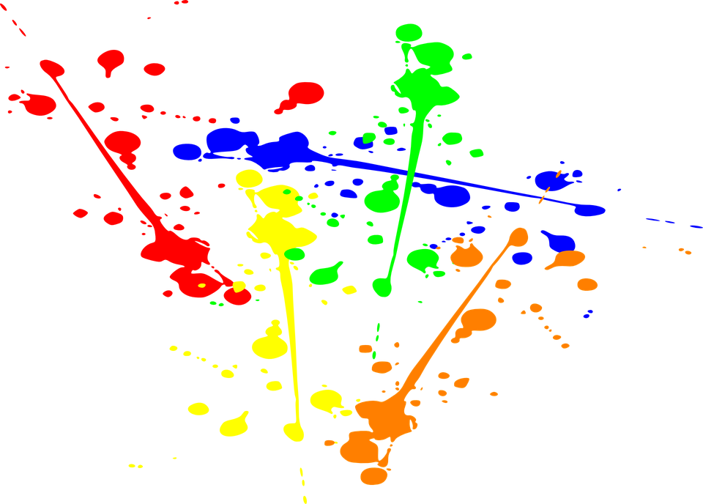

Activity A1
Keeping safe
Think of things we could do that may help prevent head injuries from happening.
Design and create a poster that shows people how they can keep safe and potentially avoid getting a head injury.

Slide 25


Activity A2
Skull design
Time to be creative. Students can now design their own colourful paper skull. Turn them in to masks or make an amazing classroom display. Use our downloadable worksheet which can be found on the St John Ambulance website.

Slide 26
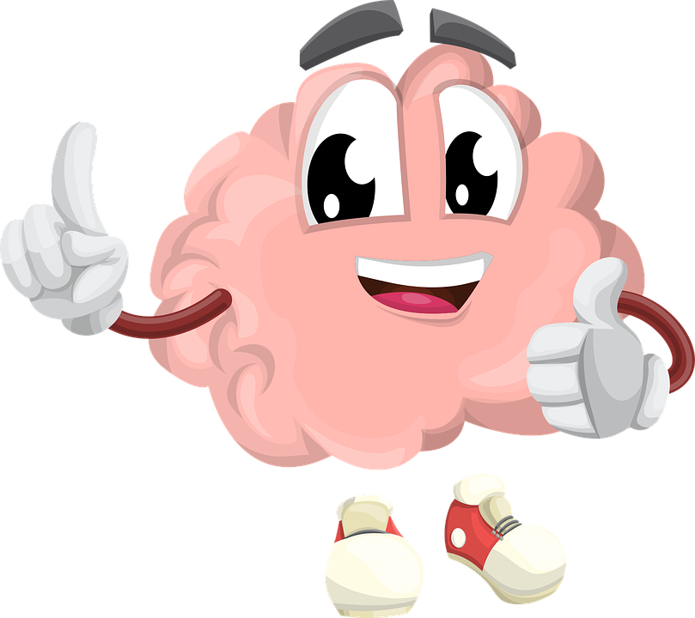
Quiz time answer sheet
1. Name one sign of a head injury.
  Answer could be: confusion, drowsiness, headache, visual disturbance, loss memory, vomiting, difficulty speaking or walking.
2. State one way to prevent a head injury.
  Answer could be: wear helmet , be aware of safety, cross road carefully, wear seat belts etc.
3. Name the part of the body which protects the brain.
  Answer: The skull
Notes:
Answers can be found at end of power point

Slide 27
Quiz time answer sheet
4. How many bones form the skull?
  Answer: 22 bones
5. Name one thing that the brain controls
  Answer could be: Brain is like a computer that controls body functions including movement, communication, regulation of body.
6. Describe how somebody would treat a head injury.
(minor/severe) - refer to your turn sheet
Bonus question…
Name one type of head injury and explain what it is
  Answer: Minor or severe
Notes:
Answers can be found at end of power point

