Slide 1
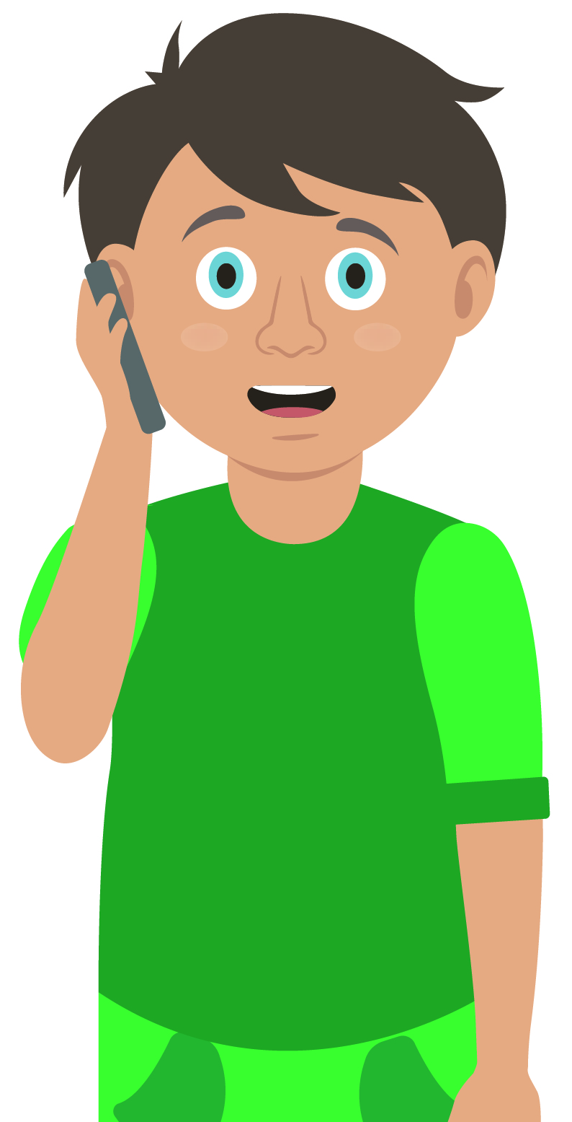
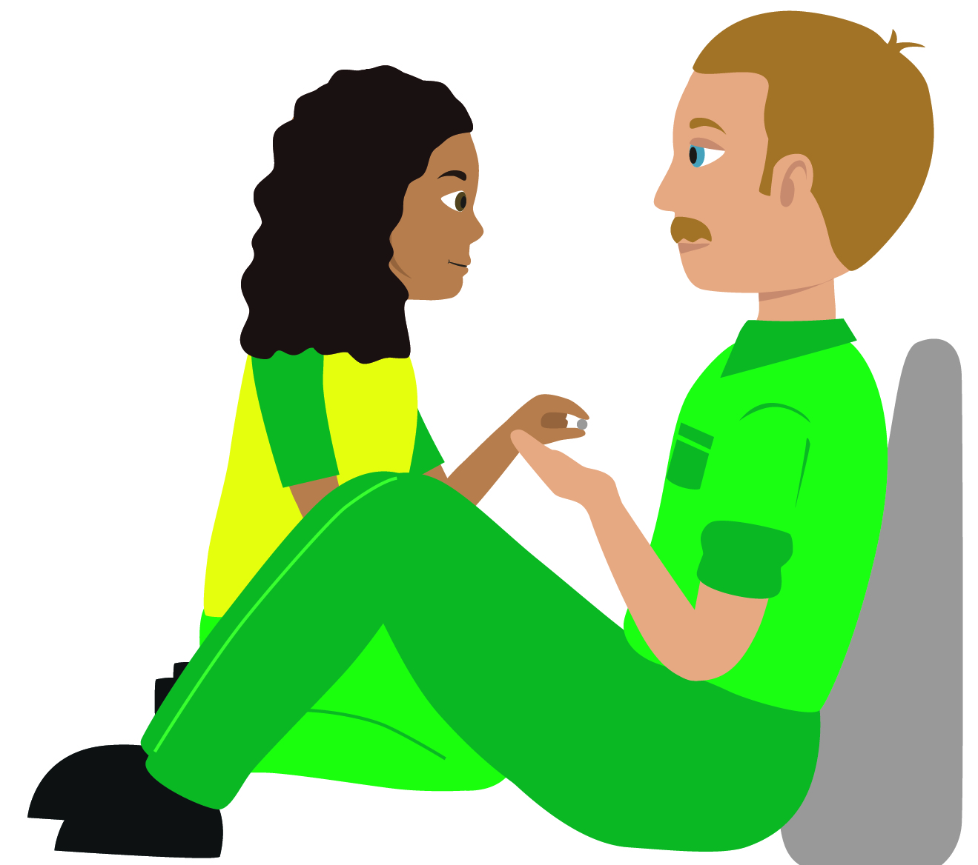
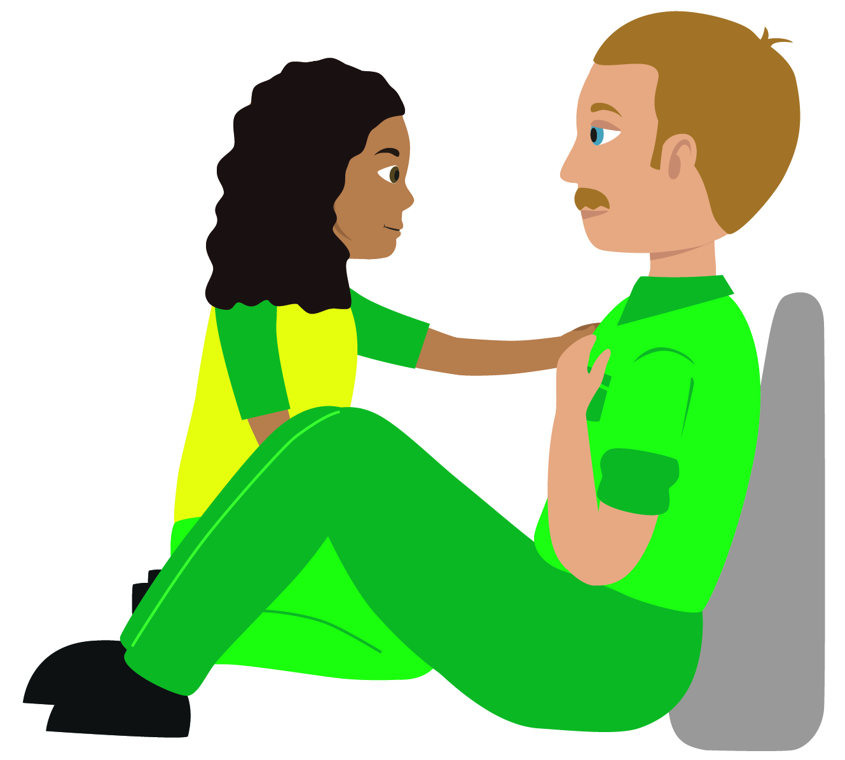
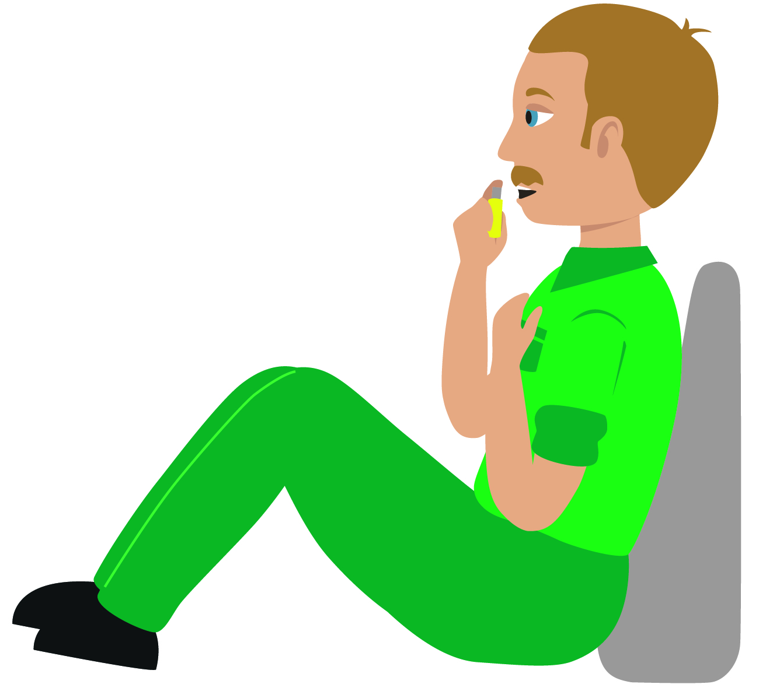

Your turn: Heart attack
Tick the box if you can successfully complete the key step…
Call 999/112 for emergency help.
Make them as comfortable as possible.
Put them in a half sitting position on the floor
Place a cushion behind their back and under their knees
3. Assist them to take one 300mg aspirin tablet.
4. If they have angina medication (tablet or spray), let them administer it.
Monitor them and keep them reassured while you wait for help to arrive
Remember, your casualty could become unresponsive. Be prepared to perform CPR
Notes:
In pairs/ small group demo management of a heart attack
Q. Why is it important that we do not let the casualty eat or drink? The casualty must be prevented from eating and drinking as their body is already under stress and digesting food / drink will put additional strain on heart. Also, if they are going to hospital they may receive treatment that requires them NOT to have eaten or drank. (operation etc)

