Slide 1
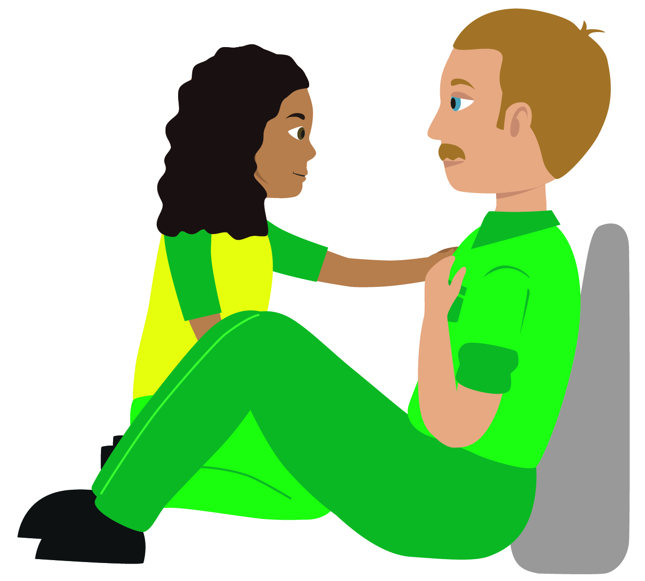
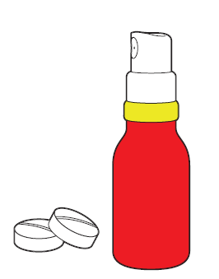
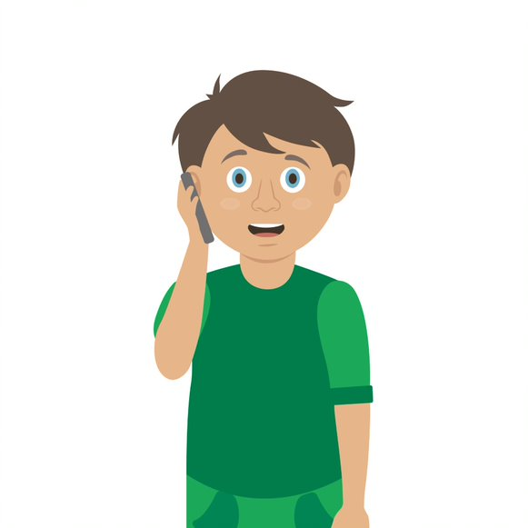
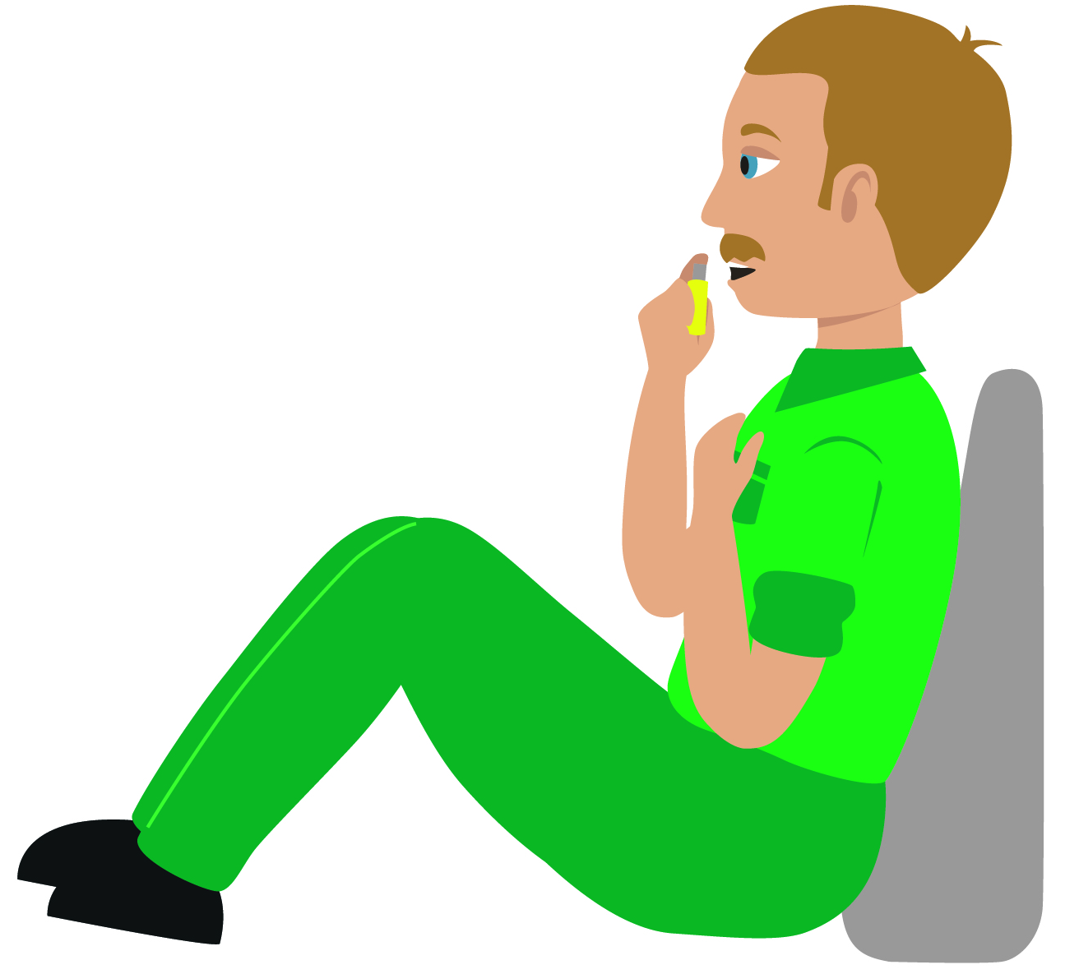

Starter Activity
Chest pain
Use your current first aid knowledge to explain what you could do for each of the 5 steps.
Step 1.
Step 2.
Step 3.
Help _________________
_____________________
Sit them down on the floor with ____________________________ their back
Encourage the casualty to ________________________________________________________ (tablet or spray)
If the pain persists after __________________________________________________________________
Step 4.
Step 5.
Call 999/112 ___________
__________________________________________ (suspect _____________)
__________________________________________until help arrives
These images may be able to help you with the answers
Notes:
Complete the steps to demonstrate knowledge of topic at start of session

Slide 2



Chest pain
KS4 – Chest pain

Slide 3
Chest pain
A short course to learn how to deal with a casualty who is having chest pain.

Slide 4
Learning outcomes
I am able to recognise when somebody is having chest pain
I can demonstrate first aid techniques that may help a casualty with chest pain
I am able to get help for a casualty with chest pain
Notes:
Teacher should refer to ground rules for the session at this stage

Slide 5
Casualty care
Always communicate with the casualty, if possible
Listen carefully to what your casualty tells you
Try to make sure you have the correct information before dialing 999 or 112

Slide 6
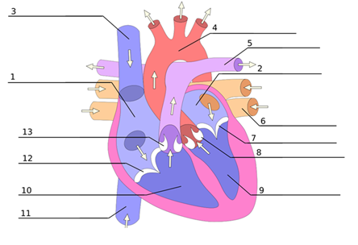

The heart A48
The heart has its own blood supply
It is approximately the size of your fist
The adult heart beats on average 60-80 times per minute
The heart has 4 different chambers
S&C: Can you name the 4 chambers of the heart?
Notes:
S&C= left ventricle, right ventricle, left atrium, right atrium.
A closed system. The heart pumps blood around the body, oxygenated blood goes to organs/ tissues in body that need oxygen to survive.
Deoxygenated blood returns to lungs for reoxygenation

Slide 7

Cardiac maths
The volume of blood in the human body is approximately 5 litres.
Every hour the heart pumps, on average, 280 litres.
Each day (24 hrs) = ? litres
Each year = ? litres
Notes:
ANS
6720 a day and 2,452,800 a year.

Slide 8
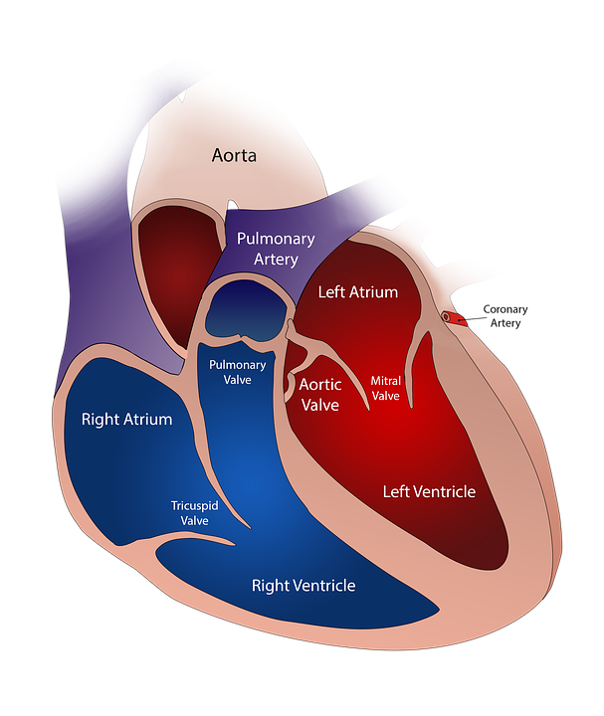
The heart
A cardiac arrest means that the heart has stopped beating normally and CPR is needed
Chest pain May be caused by the heart muscle not getting enough oxygen from the coronary arteries. Remember, not all heart attacks have chest pain

Slide 9
Watch this video
CHEST PAIN
KS4 – Chest pain
Notes:
Ensure that all students are fine to view content and will not be adversely affected.

Slide 10
Your turn:
Chest pain
Help the casualty to sit down
Sit them on the floor with pillows behind their back
2. Encourage them to take medication if they have any (tablet or spray)
3. If the pain persists after 5 minutes advise them to take another dose
4. Call 999/112 if the pain is not easing after the second dose (suspect a heart attack)
5. Keep them calm and reassure them until help arrives
Notes:
In pairs/ small group demo management of chest pain (angina)
Q. Why is it important that we do not let the casualty eat or drink? The casualty must be prevented from eating and drinking as their body is already under stress and digesting food / drink will put additional strain on heart. Also, if they are going to hospital they may receive treatment that requires them NOT to have eaten or drank. (operation etc)
Scenario cards are available which the teacher can use to make the practical activity relevant in a certain context for students.

Slide 11
Your turn:
Heart attack
Call 999/112 for emergency help.
Make them as comfortable as possible.
Put them in a half sitting position on the floor
Place a cushion behind their back and under their knees
3. Assist them to take one 300mg aspirin tablet.
4. If they have angina medication (tablet or spray), let them administer it.
Monitor them and keep them reassured while you wait for help to arrive
Remember, your casualty could become unresponsive. Be prepared to perform CPR
Notes:
In pairs/ small group demo management of a heart attack
Q. Why is it important that we do not let the casualty eat or drink? The casualty must be prevented from eating and drinking as their body is already under stress and digesting food / drink will put additional strain on heart. Also, if they are going to hospital they may receive treatment that requires them NOT to have eaten or drank. (operation etc)
Scenario cards are available which the teacher can use to make the practical activity relevant in a certain context for students.

Slide 12
Complete the sentences
If someone was having a heart attack…
They may have pain in their _____________
The colour of their skin may be _____________
They could feel ____________________
Their breathing may be _____________
S&C: Expand your answer and say why
Notes:
Pain could be present in any of the following:
Chest, back, jaw or left arm.
Note pain is not always present when a casualty is having a heart attack.
Colour of skin may be pale, they could feel anxious, sick, dizzy.
Breathing may be fast (anxiety)

Slide 13
Casualty care
Pause for thought...
Which actions do you think are most important when caring for a casualty?
Get help
No food or drink
Prevent condition worsening
Remain calm
Keep warm
Treat with dignity and respect
Reassure casualty
Communicate well
Notes:
Opportunity to discuss common casualty care skills which are necessary in all first aid situations.

Slide 14



Check your learning
I am able to:
State the different between a heart attack and a cardiac arrest
Help someone who is having chest pain
Call for help if someone is having chest pain
YES UNSURE NO

Slide 15

Check your knowledge
Chest pain
Revisit the starter activity on the first slide of this presentation. Using a coloured pen can you....
1. Add more detail to your previous answers?
2. Make any corrections?

Slide 16

Information and support
If any of the content in this session has upset or concerned you please discuss this with one of the teachers at your school
Further support can be found at:
www.childline.org.uk
www.youngminds.org.uk
www.samaritans.org
Further information linked to first aid can be found at:
www.sja.org.uk
www.asthma.org.uk

Slide 17

Thank you!

Slide 18
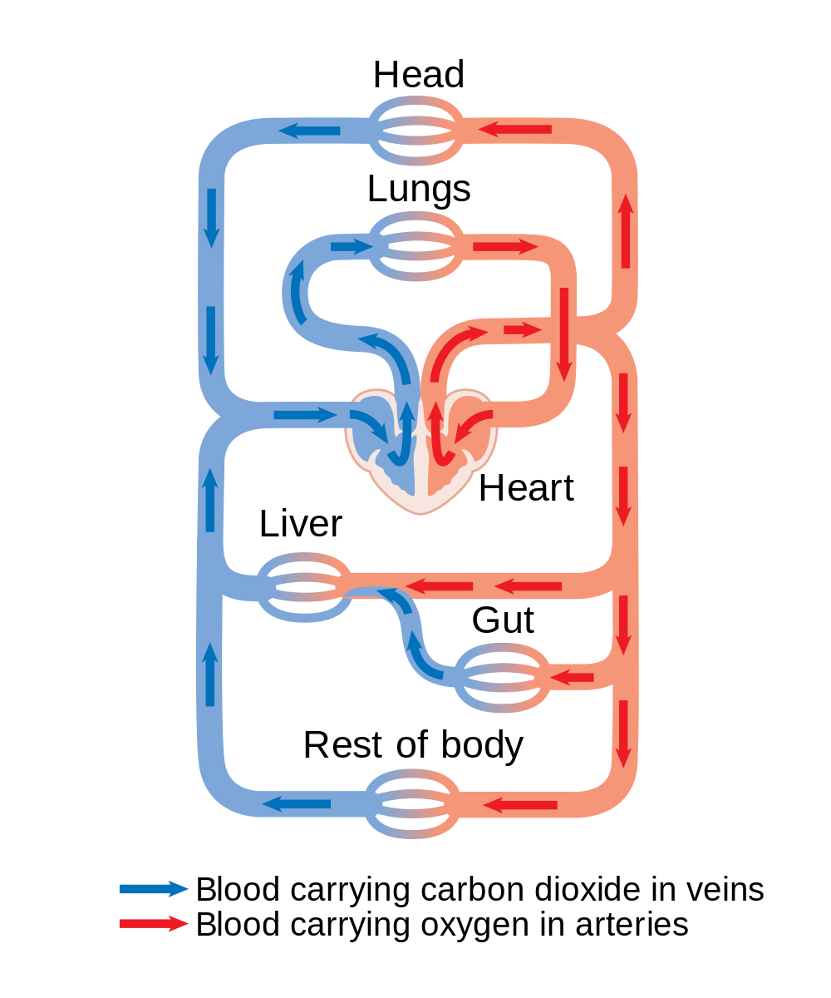
Optional activity A36 (or A49)
The circulatory system
Create your own circulatory system - bring to life the key organs of the body by being creative. Use blue and red pens/string etc. to demonstrate the flow of blood in and out of the heart and lungs to the rest of the body. Use our downloadable worksheet which can be found on the St John Ambulance website.

Slide 19
The heart A48
The heart has its own blood supply
It is approximately the size of your fist
The adult heart beats on average 60-80 times per minute
The heart has 4 different chambers
S&C: Can you name the 4 chambers of the heart?
Notes:
S&C= left ventricle, right ventricle, left atrium, right atrium.
A closed system. The heart pumps blood around the body, oxygenated blood goes to organs/ tissues in body that need oxygen to survive.
Deoxygenated blood returns to lungs for reoxygenation

Slide 20
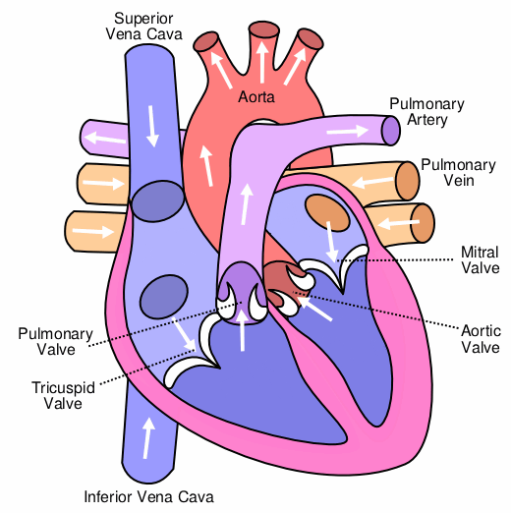
The heart A48 answers
The heart has its own blood supply
It is approximately the size of your fist
The adult heart beats on average 60-80 times per minute
The heart has 4 different chambers
S&C: Name the 4 chambers of the heart
Notes:
S&C= left ventricle, right ventricle, left atrium, right atrium.
A closed system. The heart pumps blood around the body, oxygenated blood goes to organs/ tissues in body that need oxygen to survive.
Deoxygenated blood returns to lungs for reoxgenation

Slide 21
Your turn: Heart attack
Complete the steps
Call 999/112 for emergency help.
Make them as comfortable as possible.
Put them in a ____________ position on the floor
Place a cushion behind their back and under their knees
3. Assist them to take one 300mg _________ tablet.
4. If they have angina _____________(tablet or spray), let them administer it.
Monitor them and keep them reassured while you wait for help to arrive
Remember, your casualty could become unresponsive. Be prepared to perform CPR
Notes:
In pairs/ small group demo management of a heart attack
Q. Why is it important that we do not let the casualty eat or drink? The casualty must be prevented from eating and drinking as their body is already under stress and digesting food / drink will put additional strain on heart. Also, if they are going to hospital they may receive treatment that requires them NOT to have eaten or drank. (operation etc)

