Slide 1
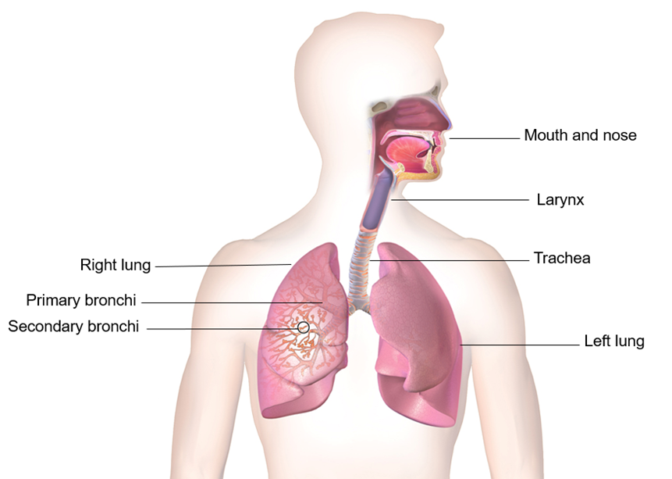
Activity A39
Be creative
Students now have the option to use flip chart paper to create a diagram that demonstrates the passage of air and food. Use the diagram to explain and label how choking may occur, research or use slides within this presentation to help with this task.

